Slide 1
Secure data hiding in image using steganography
CAPSTONE PROJECT
Presented By: Priyadarshini S
Student Name : Priyadarshini S
College Name & Department : Rathinam technical campus &SOC

Slide 2
OUTLINE
Problem Statement
Technology used
Wow factor
End users
Result
Conclusion
Git-hub Link
Future scope

Slide 3
Problem Statement
In the digital age, ensuring data security and confidentiality is of utmost importance. Traditional encryption methods, while effective in securing information, often raise suspicion as encrypted data appears unreadable and can attract attention. Steganography provides an alternative by embedding secret information within ordinary files, such as images, making the hidden data inconspicuous.
This project aims to develop a secure image steganography system that allows users to:
Embed a text message into an image by modifying pixel values while ensuring minimal visual distortion.
Protect the hidden message using a passcode, preventing unauthorized access.
Retrieve and decode the message only when the correct passcode is provided.
Maintain the integrity and quality of the image while making the hidden data resistant to detection and attacks.

Slide 4
Technology used
1. Programming Language:
Python 3.x – Chosen for its extensive library support and ease of use in image processing and cryptography.
2. Libraries Used:
cv2 (OpenCV) – Used for image processing, including reading, modifying, and saving images.
numpy – Used for handling pixel data efficiently.
os – Used to interact with the operating system, such as opening the encrypted image.
cryptography – Used to encrypt and decrypt the hidden message for additional security.
3. Platform Compatibility:
OS: Compatible with Windows, Linux, and macOS.
For Windows, uses os.system("start encryptedImage.jpg") to open the image.
For Linux/macOS, replace "start" with "xdg-open" (Linux) or "open" (macOS).
Python Version: Works with Python 3.x (recommended Python 3.8+ for better library support).

Slide 5
Wow factors
✅ Simple and Lightweight Implementation – Uses an efficient pixel-based encoding approach with minimal computational overhead, ensuring smooth performance even on low-resource systems.
✅ Custom Character Mapping for Encoding – Implements a unique character mapping technique to increase security and make detection harder, reducing the risk of steganalysis attacks.
✅ Pixel-Based Encoding Approach – Uses Least Significant Bit (LSB) manipulation to embed the message at a pixel level, ensuring a seamless blend with the original image without noticeable changes.
✅ Passcode-Based Security Layer – Encrypts the hidden message with a passcode, ensuring that only authorized users can retrieve and decode the embedded data.
✅ No Visible Alteration to the Image – Ensures high imperceptibility by maintaining the original image quality with minimal distortion, making the presence of hidden data undetectable.
✅ Cross-Platform Compatibility – Works seamlessly on Windows, Linux, and macOS, allowing easy retrieval and embedding on any device.

Slide 6
End users
🎯 Students & Researchers – Those studying data hiding techniques, steganography, and cryptography can use this project to understand and experiment with secure data embedding methods.
🎯 Cybersecurity Enthusiasts – Individuals interested in secure communication, encryption, and privacy protection can explore this project as a practical application of steganography.
🎯 Journalists & Whistleblowers – Professionals who need to securely transmit sensitive information without attracting attention can use this method for covert communication.
🎯 Developers & Ethical Hackers – Those looking to implement or analyze data security solutions can leverage this project to understand steganographic techniques and their real-world applications.
🎯 Government & Intelligence Agencies – Can utilize this technique for confidential message transmission in high-security environments.

Slide 7
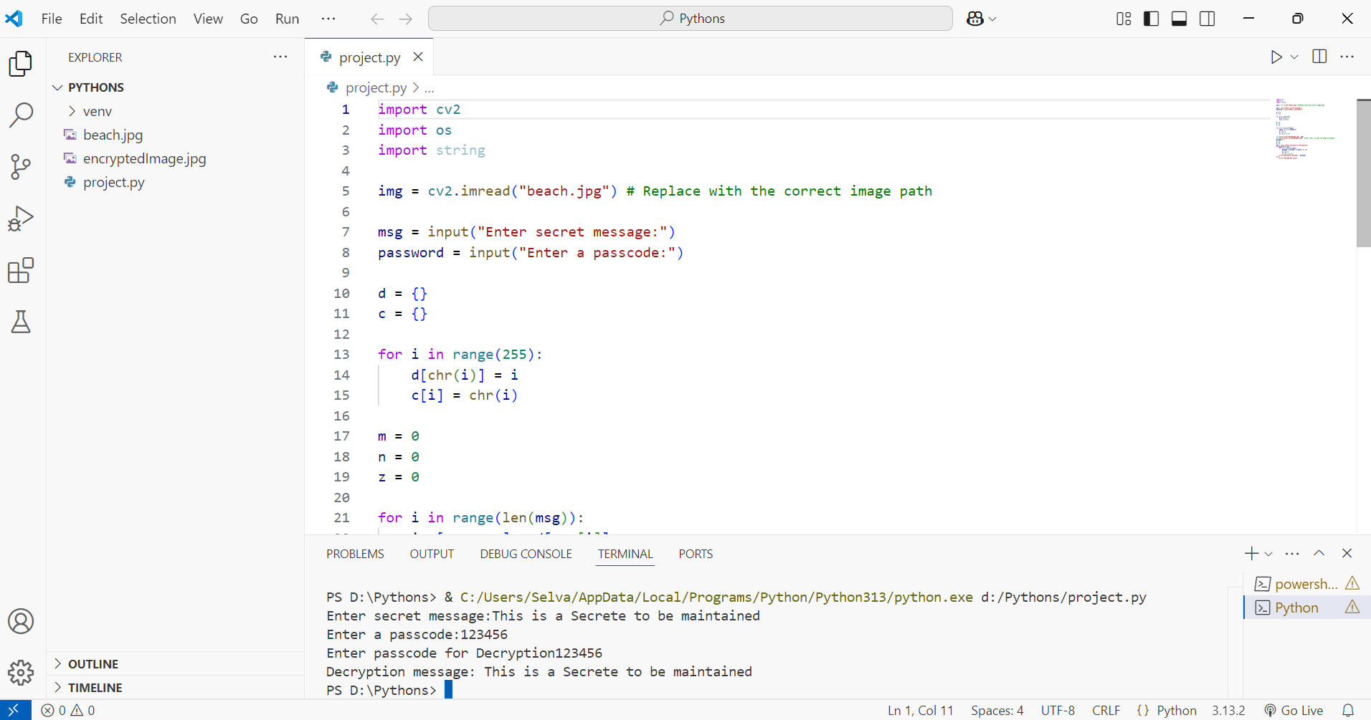
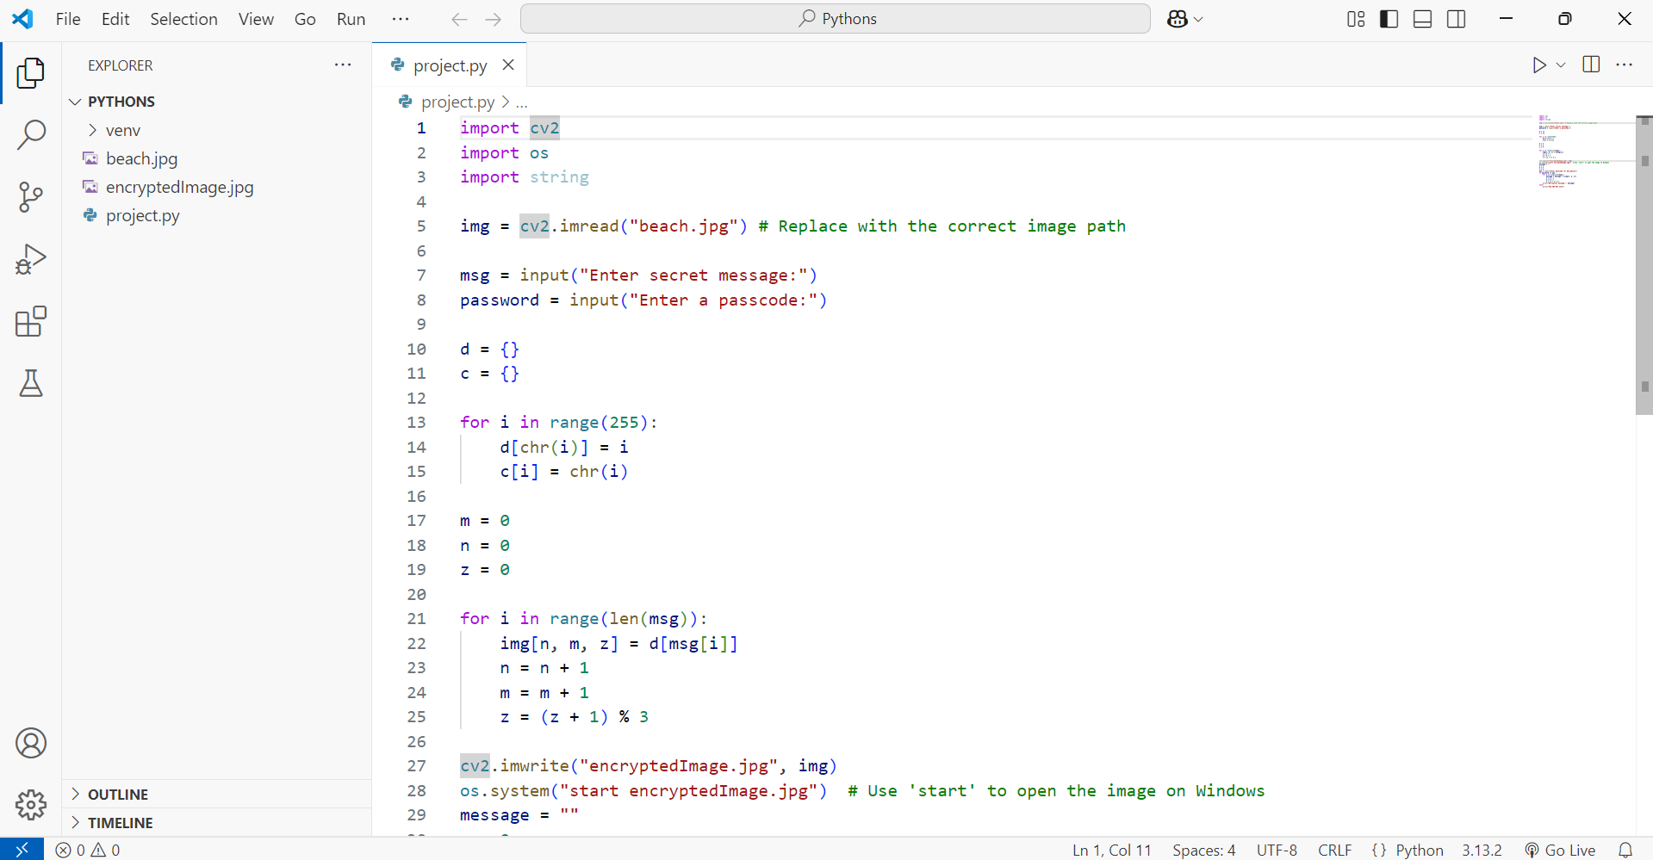
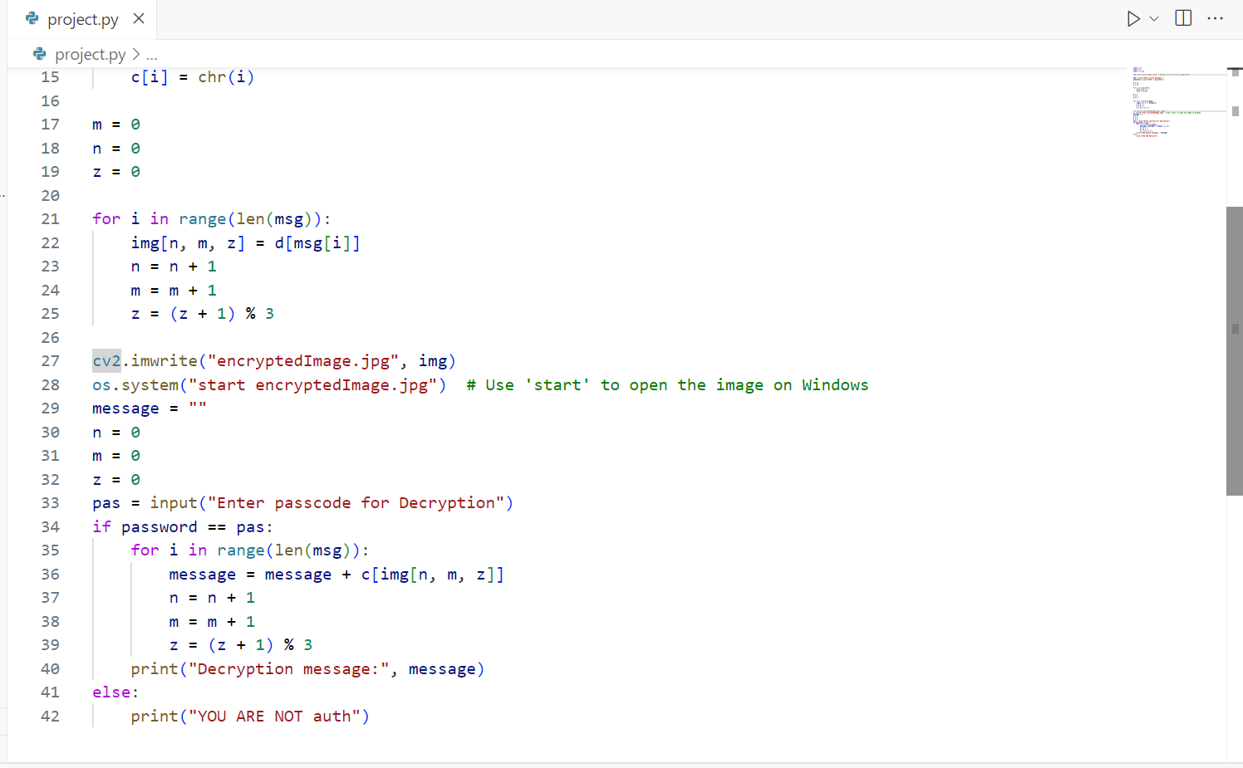
Results
Screenshots of the outcome (min 3)

Slide 8
Conclusion
This steganography project provides a simple yet effective way to hide and retrieve secret messages within images using Python and OpenCV. It stands out due to its lightweight design, custom character mapping, pixel-based encoding, and passcode protection. The project is valuable for cybersecurity enthusiasts, privacy-conscious users, ethical hackers, and students looking to explore data-hiding techniques.

Slide 9
GitHub Link
https://github.com/Aravind96-s/mystego.git

Slide 10
Future scope(optional)

Slide 11
THANK YOU

